Slide 1
Cell Transport FA
Learning Goal:
Predict movement of molecules through the cell membrane given environmental or cell conditions and describe its affect on a cell.

Slide 2
Tutorials on cell transport
http://highered.mcgraw-hill.com/sites/0072495855/student_view0/chapter2/animation__how_osmosis_works.html
http://highered.mcgraw-hill.com/sites/9834092339/student_view0/chapter38/diffusion_through_cell_membranes.html
http://highered.mcgraw-hill.com/sites/0072495855/student_view0/chapter2/animation__how_facilitated_diffusion_works.html
http://highered.mcgraw-hill.com/sites/0072495855/student_view0/chapter2/animation__how_the_sodium_potassium_pump_works.html
http://highered.mcgraw-hill.com/olcweb/cgi/pluginpop.cgi?it=swf::535::535::/sites/dl/free/0072437316/120068/bio02.swf::Endocytosis%20and%20Exocytosis

Slide 3
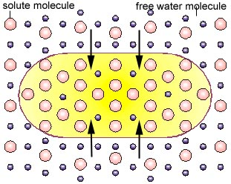
When the concentration of solute is lower in the solution than inside the cell the solution is
Hypertonic
Isotonic
Hypotonic
Aquatonic

Slide 4
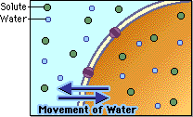
When the concentration of the solute is the same on the outside of the cell as it is inside the cell the solution is
Hypertonic
Isotonic
Hypertonic
Aquatonic

Slide 5
In which direction will the net movement of water be in the following example?
90
10 % solute
90% H₂O
5% solute 95%
H₂O
into the cell
out of the cell
equal amounts move into and out of the cell

Slide 6
What type of solution is the cell in?
10 % solute
90% H₂O
Hypotonic
Isotonic
Hypertonic
Aquatonic
20% solute80% H₂O

Slide 7
What type of solution is the cell in?
10 % solute
90% H₂O
Hypotonic
Isotonic
Hypertonic
Aquatonic
10% solute
90% H₂O

Slide 8
What type of solution is the cell in?
30 % solute
70% H₂O
Hypertonic
Isotonic
Hypotonic
Aquatonic
10% solute
90% H₂O

Slide 9
In which direction will the net movement of water be in the following example?
30 % solute
70% H₂O
Into the cell
Out of the cell
equal amounts move into and out of the cell
10% solute 90% H₂O

Slide 10
The cytoplasm in the cell is
30 % solute
70% H₂O
hypertonic
hypotonic
isotonic
aquatonic
10% solute 90% H₂O

Slide 11
What type solution is the cell in?
75% free water
25% solute
Hypertonic
Hypotonic
Isotonic
aquatonic
80% free water
20% solute

Slide 12
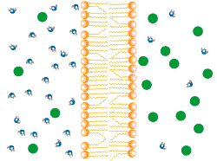
What process explains movement of water into hypertonic or out of hypotonic cells?
Osmosis
Diffusion
Active transport
Facilitated
Diffusion
Net movement of water through aquaporin channel protein
http://leavingbio.net/osmosis%20and%20diffusion.htm#osex

Slide 13
Red blood cells & other animal cells which don’t have a cell wall burst if they are in what type of a solution? Small dots are water molecules; larger dots are solute.
No change cell size | Cell swells & takes on water | Cell shrinks due To losing water
Hypertonic
Isotonic
Hypotonic
Aquatonic

Slide 14
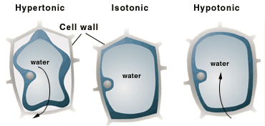
Why don’t plant cells burst after lots of rain makes the soil hypotonic compared to the cell cytoplasm?
Plant cells have aquaporin channels
Plant cells have cell walls
Plant cells have cell membranes

Slide 15
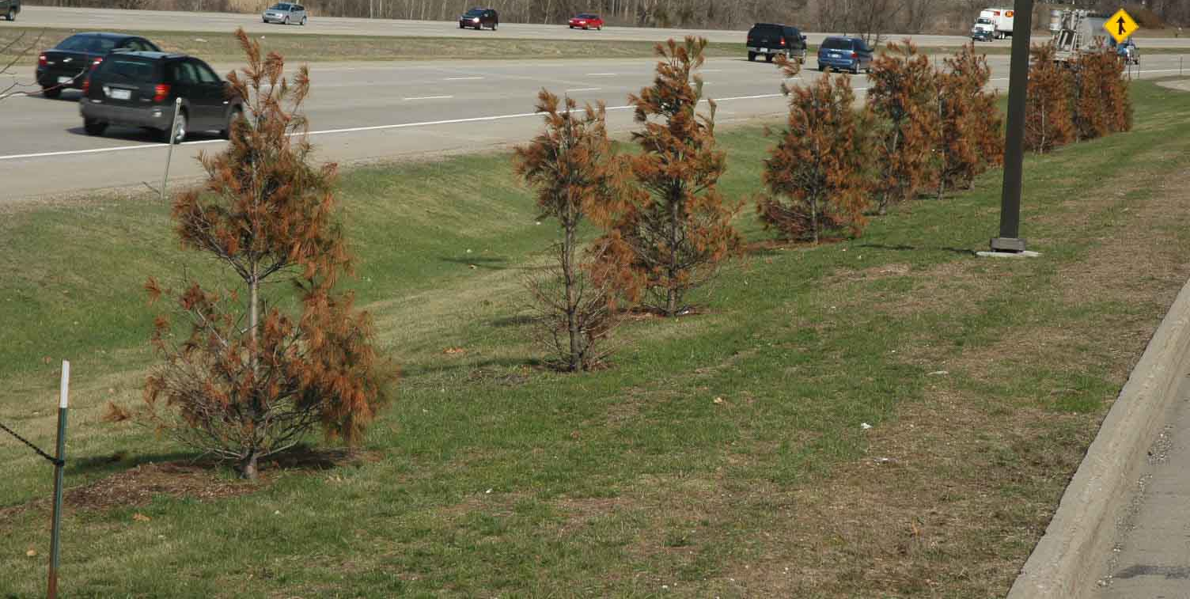
Why do plants die by plasmolysis (plasma membrane breaking) near salted highways and sidewalks?
They burst by taking in too much water from hypotonic soil
They release so much water to the hypertonic soil that their membranes shrink & break

